Slide 1


Douglas Lacerda
29/04/2022

Slide 2

Outline
Executive Summary
Introduction
Methodology
Results
Conclusion
Appendix

Slide 3
Executive Summary
Open-source SpaceX launch data was gathered from SpaceX API and Wikipedia. The data was cleaned and prepared for analysis. The Payload missing values were substituted by average, data other than related to falcon 9 data were removed. The prepared dataset was made available in a SQL database on cloud.Ibm service. A dashboard was prepared to allow fast analysis and will be delivered to the clients. As the first step, the categorical data was encoded in one-hot format, and an exploratory data analysis (EDA) was done in the search for insights. Through this approach, it was possible to identify the effects of Flight number, launch site, payload, and orbit type on success rate. The same data was used to exhibit the launch sites on a map. The prediction of success was done by training Logistic regression (LR), Support Vector Machine (SVM), Decision Tree (Tree), and K neighbors classifiers. The final accuracy was compared, and the effect of the test set size was studied.

Slide 4
Introduction
A rocket is made of stages that are, usually, destroyed during its use. SpaceX’s can launch Falcon 9 rockets and recover the first stage, but sometimes there are problems, and the first stage are destroyed too. We will determine if SpaceX will be reusable training machine learning models and use public information to predict if SpaceX will reuse the first stage.
Project background and context
Problems you want to find answers

Slide 5

Section 1

Slide 6
Methodology
Executive Summary
Data collection methodology:
Open-source SpaceX launch data was gathered from SpaceX API and Wikipedia. The data was cleaned and prepared for analysis. The Payload missing values were substituted by average, data other than related to falcon 9 data were removed.
Perform data wrangling
The data was analyzed, and a landing outcome class was created.
Perform exploratory data analysis (EDA) using visualization and SQL
Perform interactive visual analytics using Folium and Plotly Dash
Perform predictive analysis using classification models
The dataset was splited in train and test sets. Four classifications models were calibrated in the training set with hyperparameters optimized by grid search with crossvalidation. The accuracy was calculated on test set.

Slide 7
Data Collection
Open-source SpaceX launch data was gathered from SpaceX API and Wikipedia. The data was cleaned and prepared for analysis. Each workflow will be presented on following slides.

Slide 8
Data Collection – SpaceX API
Request Data from API
Normalize to json
The data was cleaned and prepared for analysis. The Payload missing values were substituted by average, data other than related to falcon 9 data were removed,and a landing outcome class was created
Get values from json
Save as dataframe
Slice Falcon 9 data
https://github.com/dlpLacerda/IBM-data-science-capstone/blob/main/1_1_Data%20Collection%20API.ipynb
Replace missing values
Create landing outcome class

Slide 9
Data Collection - Scraping
Request Data
The Falcon 9 data was scrapped from a Wikipedia page using BeautifulSoup API. The column names and its values were extracted from the html table.
Create Soup object
Extract column names
Parse html tables
https://github.com/dlpLacerda/IBM-data-science-capstone/blob/main/1_2_Data%20Collection%20with%20Web%20Scraping%20lab.ipynb
Create dataframe
Save csv

Slide 10
Data Wrangling
Count nulls
Verify types
Count launches by site
Calculate launches by orbit
Calculate outcome by orbit
The data was analyzed, and a landing outcome class was created.
https://github.com/dlpLacerda/IBM-data-science-capstone/blob/main/1_3_Data%20Wrangling.ipynb

Slide 11
EDA with Data Visualization
Flight Number vs. Launch Site: observe the success rate as the Flight number increases for different launch sites
Payload vs. Launch Site : observe the success rate as function of payload for different launch sites.
Success Rate vs. Orbit Type: observe the effect of the orbit on success rate
Flight Number vs. Orbit Type: observe the success rate as the Flight number increases for different Orbit types
Payload vs. Orbit Type: observe the success rate as function of payload for different orbit types.
Launch Success Yearly Trend: Learning effect on success rate.
https://github.com/dlpLacerda/IBM-data-science-capstone/blob/main/2_2_EDA%20with%20Visualization%20lab.ipynb

Slide 12
EDA with SQL
All Launch Site Names:
Launch Site Names Begin with 'CCA'
Total Payload Mass
Average Payload Mass by F9 v1.1
First Successful Ground Landing Date
Successful Drone Ship Landing with Payload between 4000 and 6000
Total Number of Successful and Failure Mission Outcomes
Boosters Carried Maximum Payload
2015 Launch Records
Rank Landing Outcomes Between 2010-06-04 and 2017-03-20
https://github.com/dlpLacerda/IBM-data-science-capstone/blob/main/2_1_Complete%20the%20EDA%20with%20SQL.ipynb

Slide 13
Build an Interactive Map with Folium
Launch sites’ name as a string mark: to identify launch site
Launch sites’ location as a blue circle mark: to identify launch site location
Success/failed launches for each site as cluster marker: to visualize success
Distance to highway: to identify nearby city infrastructure
https://github.com/dlpLacerda/IBM-data-science-capstone/blob/main/3_1_Complete%20the%20Data%20Visualization%20with%20Folium.ipynb

Slide 14
Build a Dashboard with Plotly Dash
Launch success count for all sites: identify most successfully used launch site.
Success ratio by site: identify highest launch success ratio
Payload vs. Launch Outcome: identify most successiful buster and payload.
https://github.com/dlpLacerda/IBM-data-science-capstone/blob/main/3_2_Build%20an%20Interactive%20Dashboard%20with%20Ploty%20Dash.py

Slide 15
Predictive Analysis (Classification)
Load the dataframe
Create features array, X
Standardize features
Create labels array, Y
Split in train and test
Find best hyperparameters by grisearchcv
Calculate the accuracy
Compare results
The prediction of success was done by training Logistic regression (LR), Support Vector Machine (SVM), Decision Tree (Tree), and K neighbors classifiers. The final accuracy was compared, and the effect of the test set size was studied.
https://github.com/dlpLacerda/IBM-data-science-capstone/blob/main/4_1_Machine%20Learning%20Prediction%20lab.ipynb

Slide 16
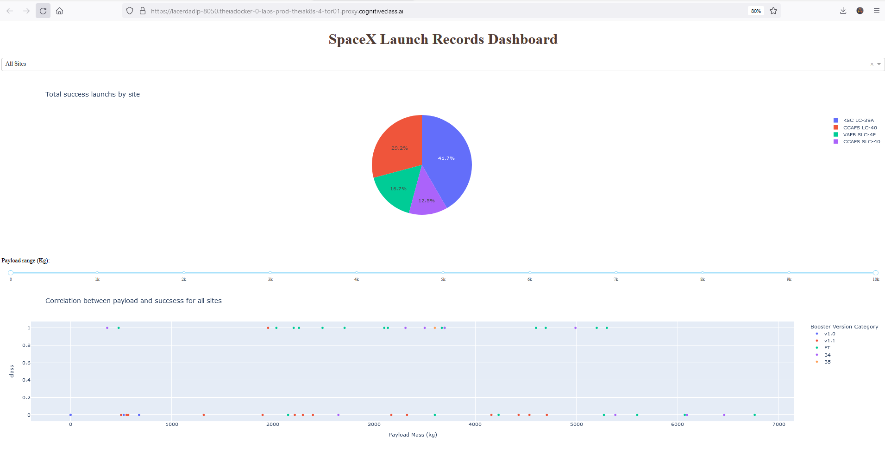
Results
Exploratory data analysis results
increasing of success rate as the Flight number increases
The success rate of some launch sites are affected by payload
The launch success appears related to the number of flights for the LEO orbit
The success rate appears to increase for payloads bigger than 4000kg appears in launches on Po, LEO and ISS orbits
There is a remarkable increase in success rate as a function of time since 2013.
Predictive analysis results
The test set size affects the accuracy
For a size of 0.4, the knn is the best model.
Interactive analytics demo in screenshots

Slide 17

Section 2

Slide 18
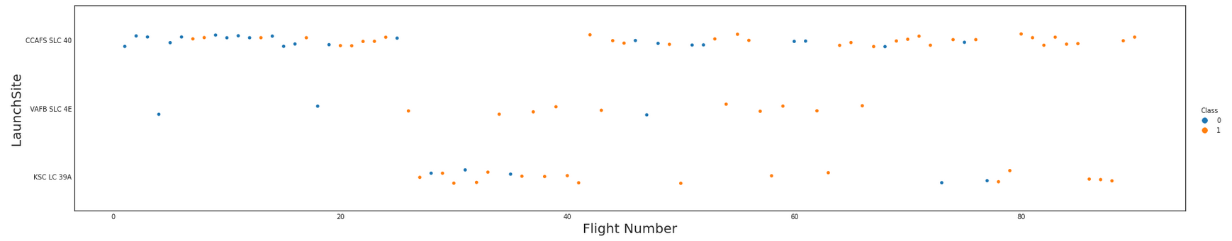
Flight Number vs. Launch Site
It is possible to observe the increasing of success rate as the Flight number increases.
KSC LC 39A initially not used.

Slide 19
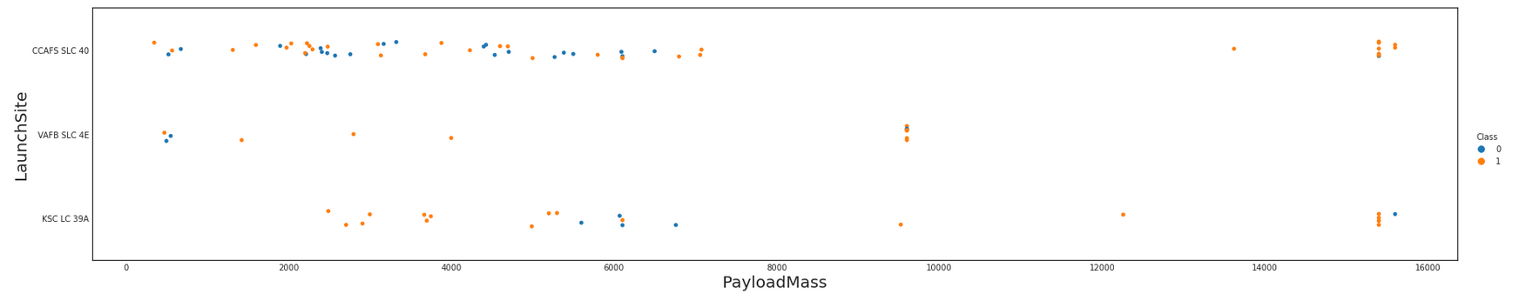
Payload vs. Launch Site
- the success for launches from CCAFS SLC 40 are not affect by payload.
- there is a high success rate for launches from KSC LC 39A when payload below 6000kg
- there is no launches with payload beyond 10000kg from site VAFB SLC 4E

Slide 20
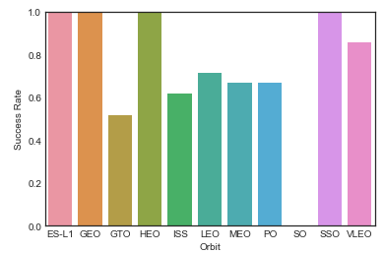
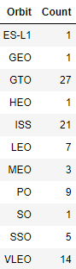
Success Rate vs. Orbit Type
Bar chart for the success rate of each orbit type. We also show a table with the number of launches for each Orbit.
There is just one launch for the orbits ES-L1, GEO, HEO, and SO. Consequently, there is no statical meaning to the Success Rate on these points.

Slide 21
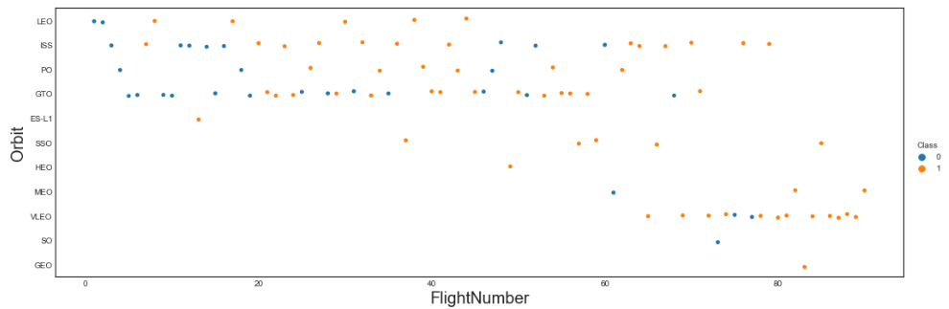
Flight Number vs. Orbit Type
The launch success appears related to the number of flights for the LEO orbit

Slide 22
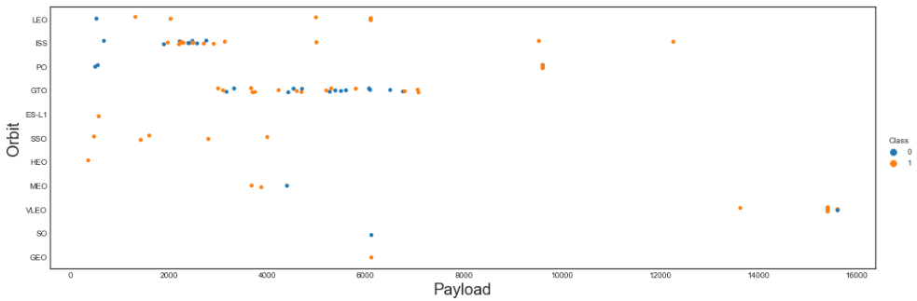
Payload vs. Orbit Type
- The success rate appears to increase for payloads bigger than 4000kg appears in launches on Po, LEO and ISS orbits
- It is not possible identify an effect of payload on success rate for launches from the GTO orbit.

Slide 23
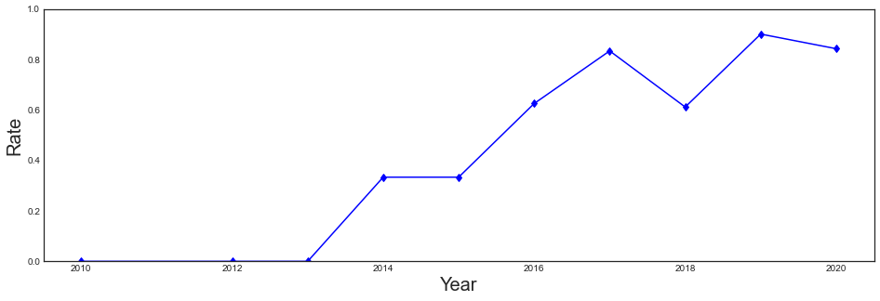
Launch Success Yearly Trend
- There is a remarkable increase in success rate as a function of time since 2013.

Slide 24
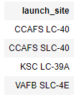
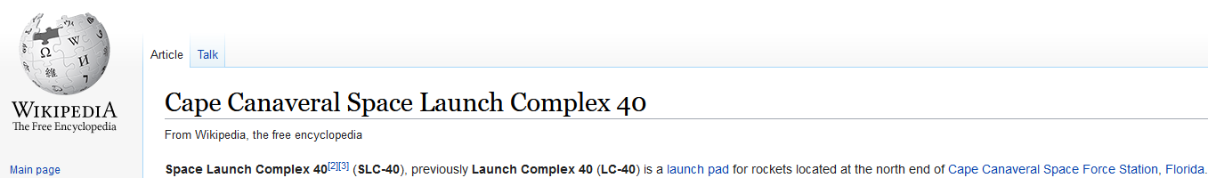
All Launch Site Names
As pointed in the wikipedia page, CCAFS LC-40 is the old name of the launch site CCAFS SLC-40. Both names identify the same place.
https://en.wikipedia.org/wiki/Cape_Canaveral_Space_Launch_Complex_40

Slide 25
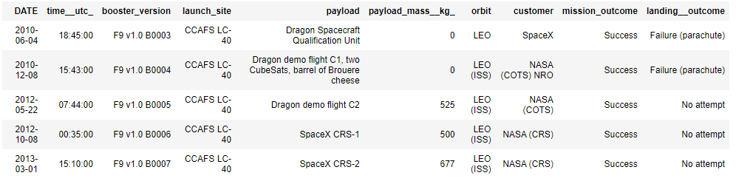
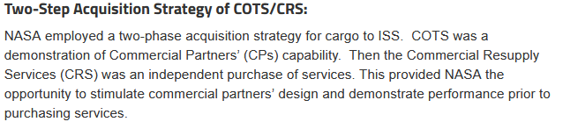
Launch Site Names Begin with 'CCA'
- 5 launchs from CCAFS
- The table show two strings for NASA customer: NASA COTS and NASA (CRS). The CRS is a purchased launch.
https://www.nasa.gov/commercial-orbital-transportation-services-cots

Slide 26
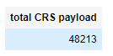
Total Payload Mass
The Nasa purchased launches are identified by the CRS string.

Slide 27
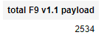
Average Payload Mass by F9 v1.1
Average payload mass carried by booster version F9 v1.1

Slide 28
First Successful Ground Landing Date
First successful landing outcome on ground pad identified as 'Success (ground pad)’ on the landing__outcome column

Slide 29
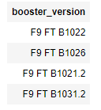
Successful Drone Ship Landing with Payload between 4000 and 6000
%%sql
SELECT booster_version from SWT84033.SPACEXDATASET where landing__outcome = 'Success (drone ship)' AND payload_mass__kg_ between 4000 and 6000
Names of boosters which have successfully landed on drone ship and had payload mass greater than 4000 but less than 6000. The landing condition found using landing__outcome = 'Success (drone ship)’ and the mass condition found using AND payload_mass__kg_ between 4000 and 6000.

Slide 30
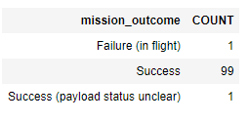
Total Number of Successful and Failure Mission Outcomes
Total number of successful and failure mission outcomes

Slide 31
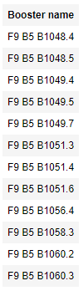
Boosters Carried Maximum Payload
%%sql
SELECT unique(booster_version) as "Booster name" from SWT84033.SPACEXDATASET where payload_mass__kg_ = (SELECT max(payload_mass__kg_) from SWT84033.SPACEXDATASET) ;
List the names of the booster which have carried the maximum payload mass. The maximum payload was found in a subquery

Slide 32
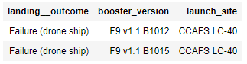
2015 Launch Records
%%sql
SELECT landing__outcome, booster_version, launch_site from SWT84033.SPACEXDATASET where landing__outcome ='Failure (drone ship)' and DATE like '2015%';
List of the failed landing_outcomes in drone ship, their booster versions, and launch site names for in year 2015

Slide 33
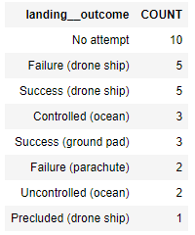
Rank Landing Outcomes Between 2010-06-04 and 2017-03-20
%%sql
SELECT landing__outcome, count (*) as count from SWT84033.SPACEXDATASET where DATE between '2010-06-04' and '2017-03-20' group by landing__outcome order by count desc;
Rank of the count of landing between the date 2010-06-04 and 2017-03-20, in descending order

Slide 34

Section 3

Slide 35

Launch sites’ location
The launch sites are identified by orange points on the map.

Slide 36
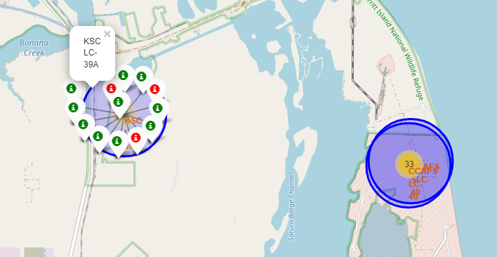
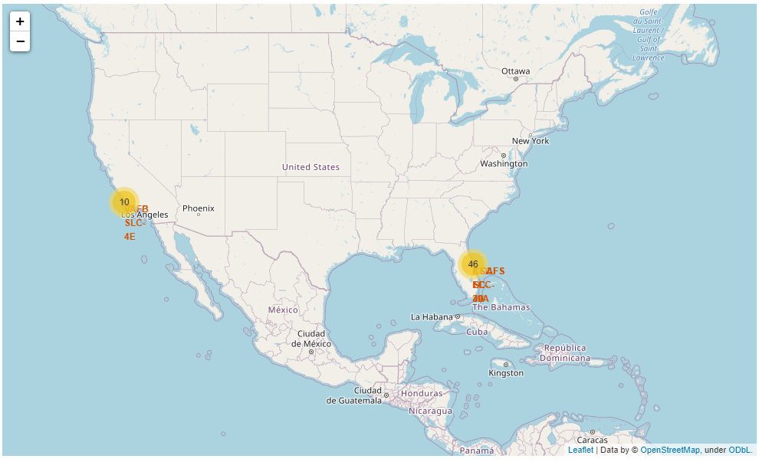
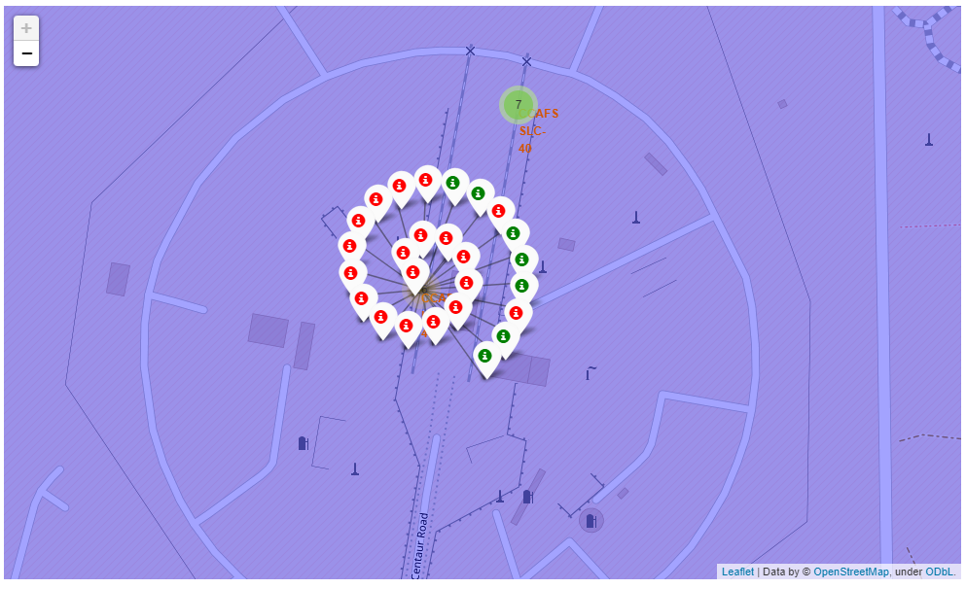
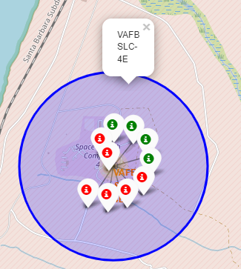
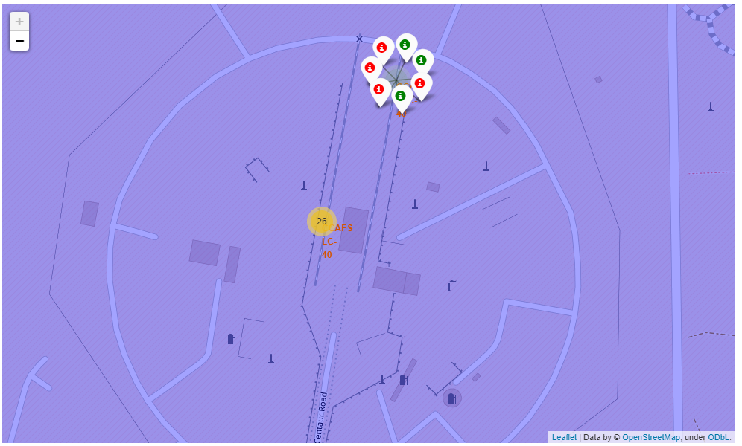
Success/failed launches for each site
The yellow marks clusters of launches with a count.
After zoom, the sites are identified, and it is possible click and se successful (green) and failed (red) launchs.

Slide 37
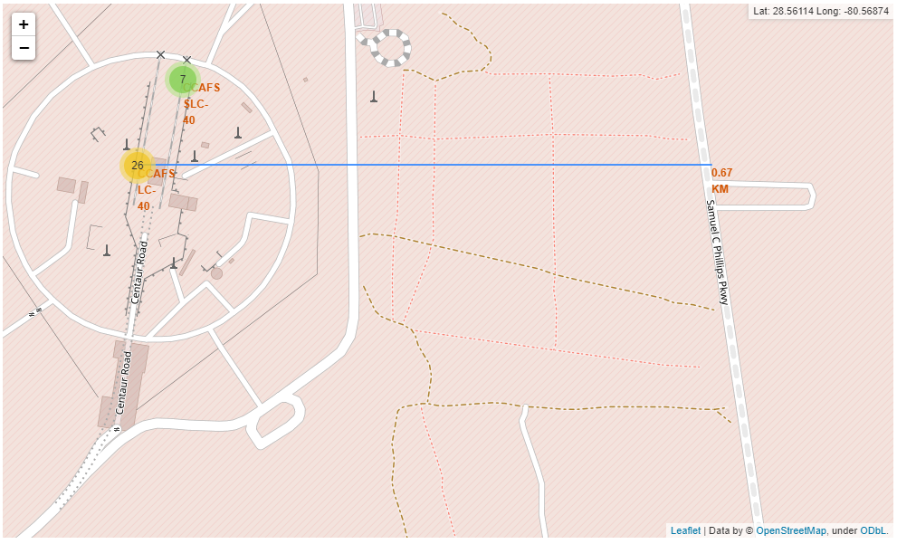
Distance to highway
Distance of 0.67km from highway identified on map
Notes:
Replace <Folium map screenshot 3> title with an appropriate title
Explore the generated folium map and show the screenshot of a selected launch site to its proximities such as railway, highway, coastline, with distance calculated and displayed
Explain the important elements and findings on the screenshot

Slide 38

Section 4

Slide 39
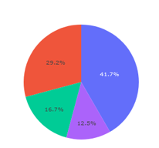
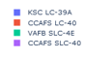
Launch success count for all sites
Piechart of launch success count for all sites identified in the legend.

Slide 40
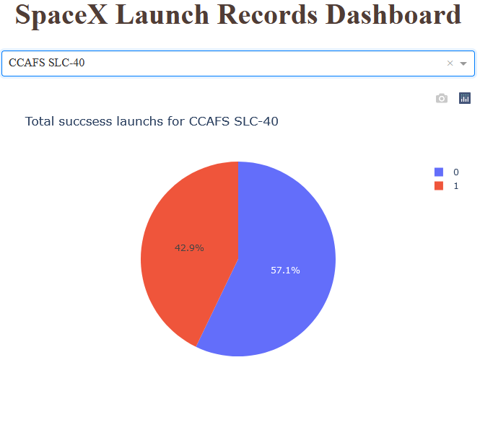
Highest launch success ratio
Piechart for the launch site CCAFS SLC-40 that has the highest launch success ratio

Slide 41
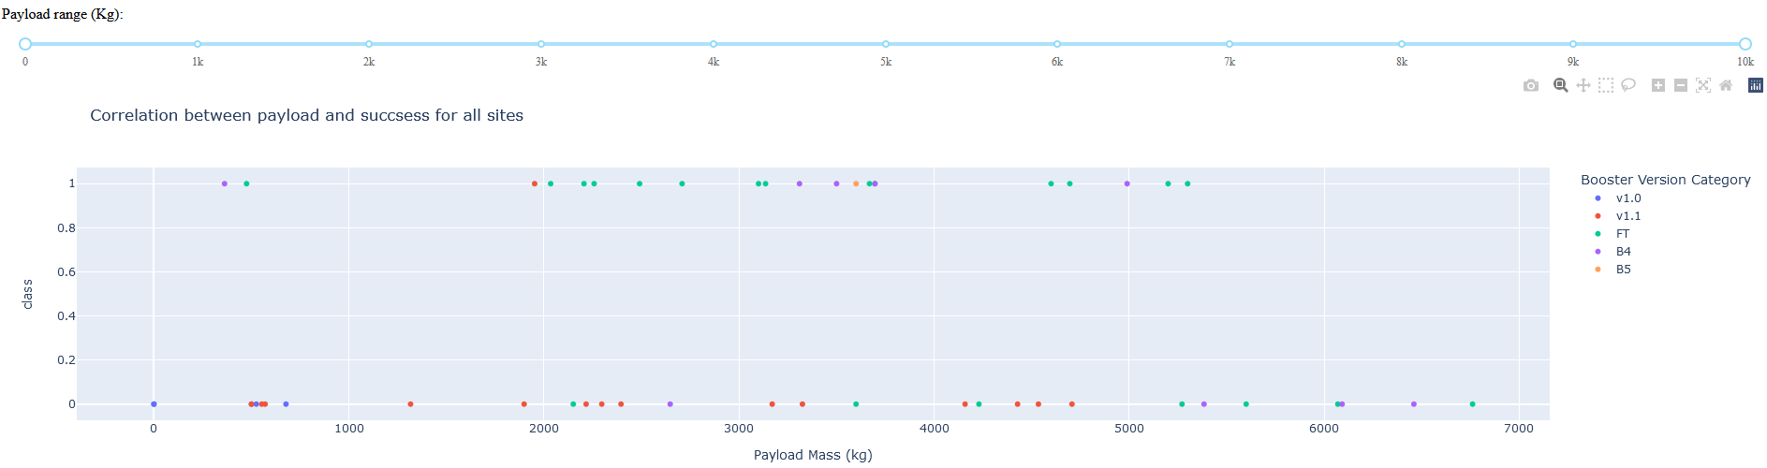
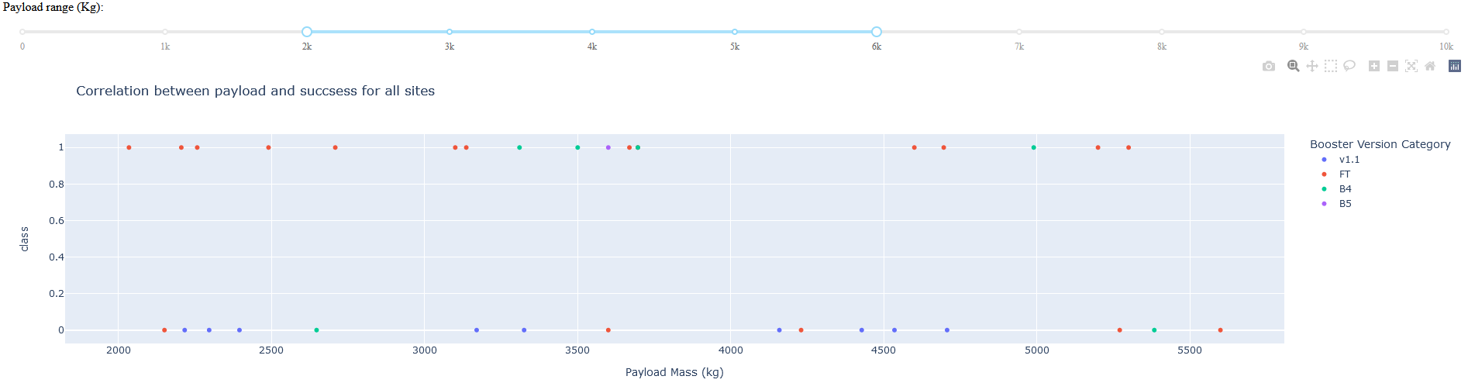
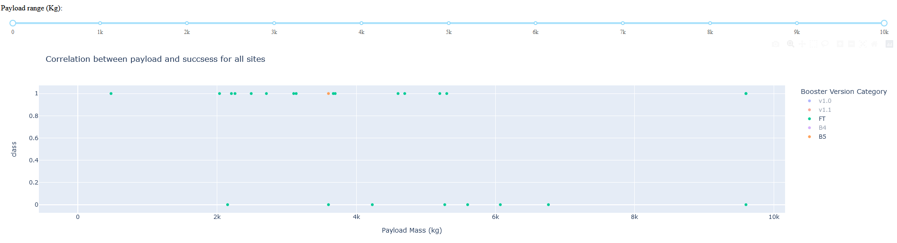
Payload vs. Launch Outcome
(a)
Dashboard graph showing payload versus launch outcome with (a) full payload selection, (b) payload between 2k and 6k, and (c) highest success rate boosters.
From (c) it is possible identify FT as the most successful booster.
(b)
(c)

Slide 42

Section 5

Slide 43
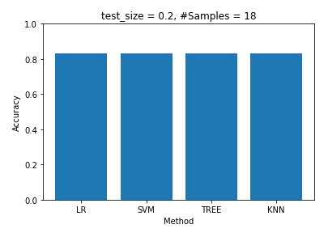
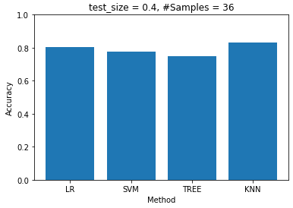
Classification Accuracy
All the models have the same accuracy for a test_size=0.2. Increasing this parameter to 0.4 also increase the number of samples on the test set from 18 to 36 and reveal a slight variation between the models with a better accuracy for the KNN.

Slide 44
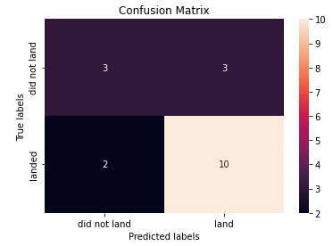
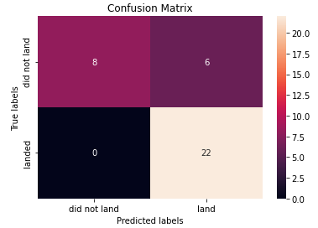
Confusion Matrix
The confusion matrix were the same for all the used models when the test_size = 0.2 (upper figure). The bottom figure show the confusion matrix for the KNN when test_size = 0.4.
Both results are indicating a good identification for the ‘land’ outcome, but there is a significative problem with false positives.

Slide 45
Conclusions
Payload, Launch Site, booster, number of flight and time variables are features that affect the success rate
There were more launchs on east coast
The test size affects the acuracy
All models predicted the landing with the same 0.833 accuracy, probably, as consequence of the small test set. The knn model has a better accuracy for the test set when test_size=0.4.

Slide 46
Appendix
Git: https://github.com/dlpLacerda/IBM-data-science-capstone

Slide 47


